Slide 1
Democratic Backsliding I
POL1036: Comparative European Politics – Lecture 15
26/03/2026

Slide 2
Schedule
Today:
Democratic Backsliding?
Democracy – Hybrid – Authoritarianism
Competitive Authoritarian Regimes
Monday: Role of Political Actors & Voters

Slide 3
(Ideal) Regime Types
 | Democratic | Authoritarian/Autocratic
Elections | Free and fair | Restricted, unfair and uncompetitive
Citizen Participation | Promoted | Minimal
Governance | Accountable & transparent | Unaccountable & corrupt
Separation of Powers | Independent judiciary, executive and legislative | Limited autonomy, under state control
Lawfulness | Rule of Law | Rule by law

Slide 4
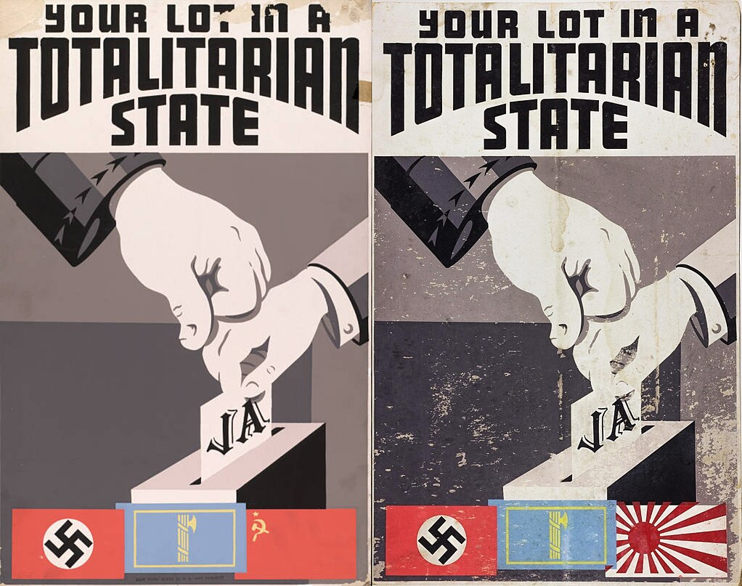
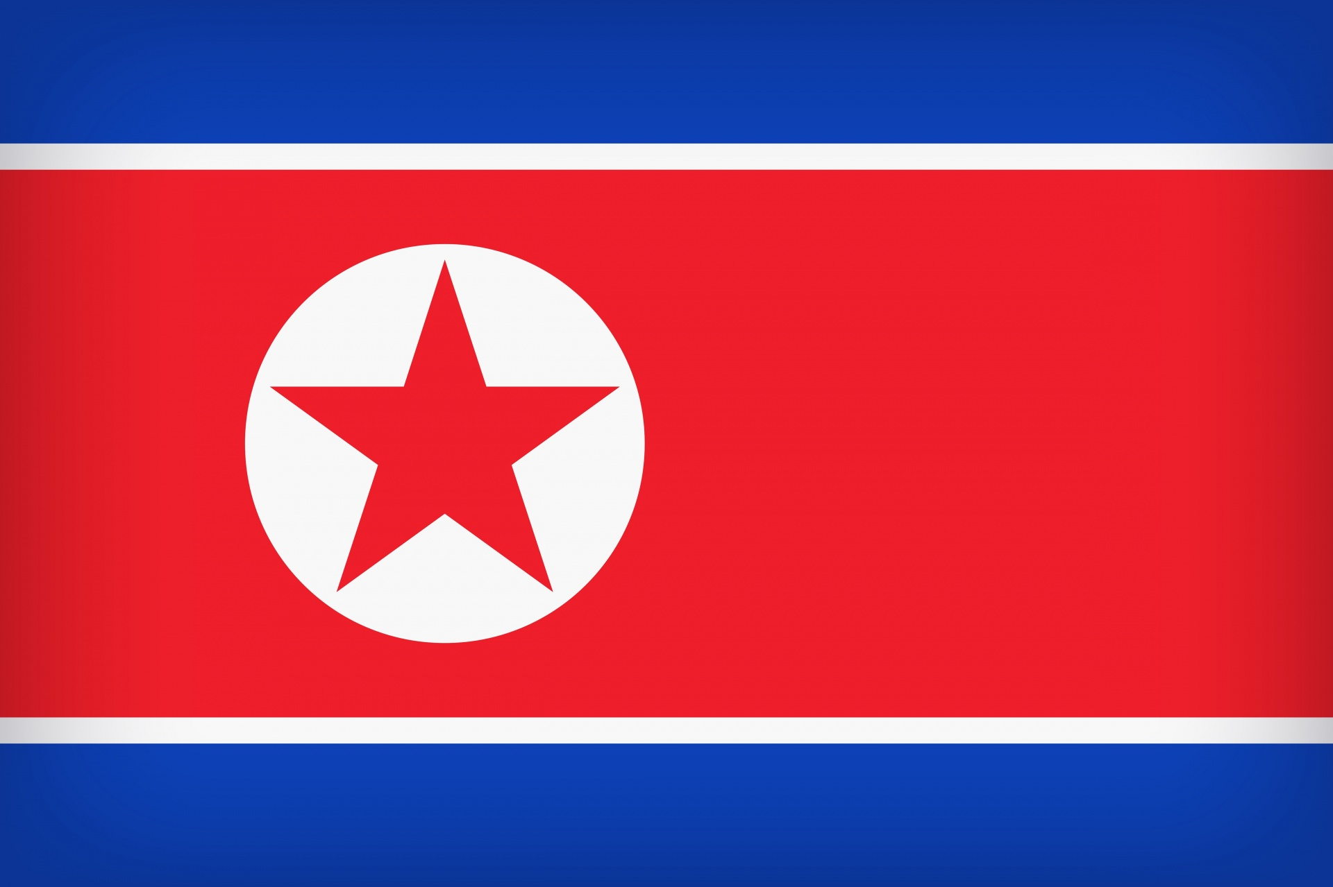
Extreme Case: Totalitarian Regimes

Slide 5
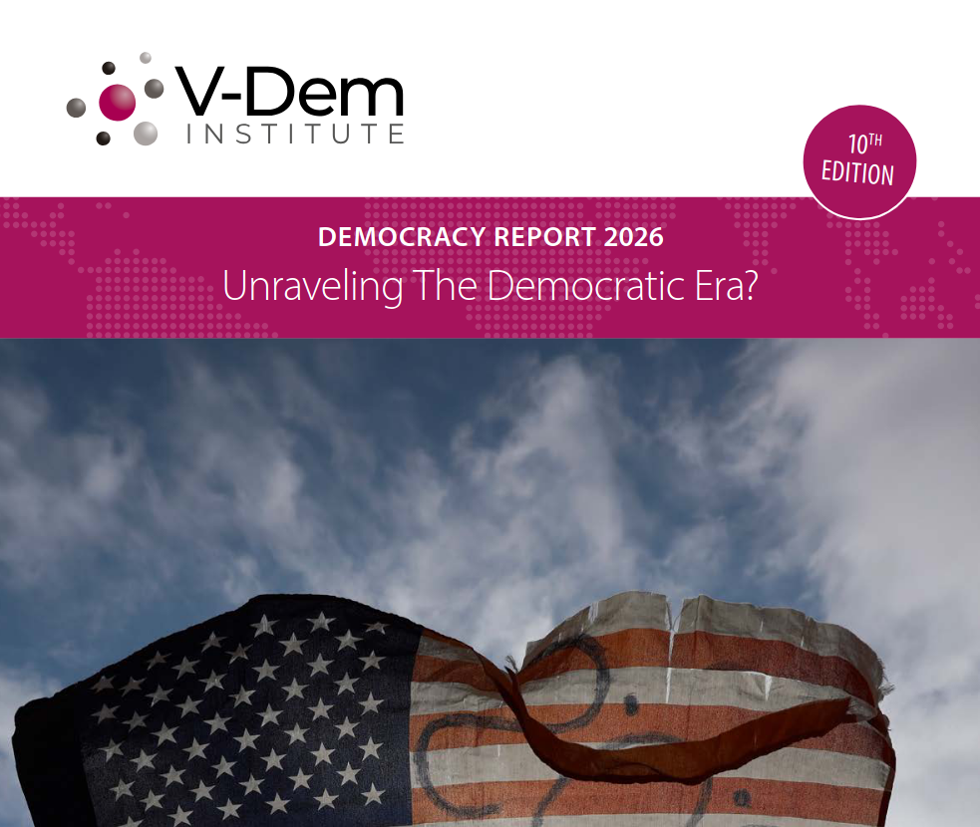
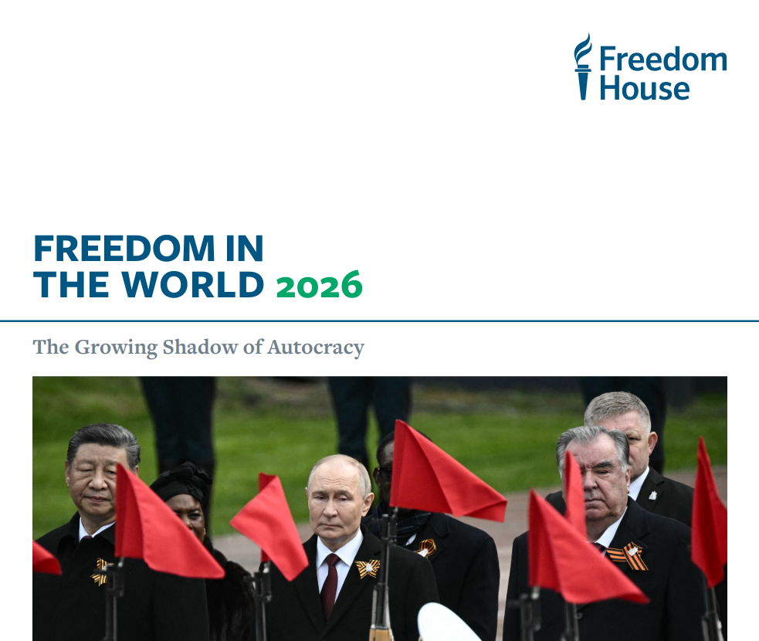
Democracy Around the World?
https://www.v-dem.net/documents/75/V-Dem_Institute_Democracy_Report_2026_lowres.pdf
https://freedomhouse.org/sites/default/files/2026-03/FIW2026_final_digital%20%281%29.pdf

Slide 6
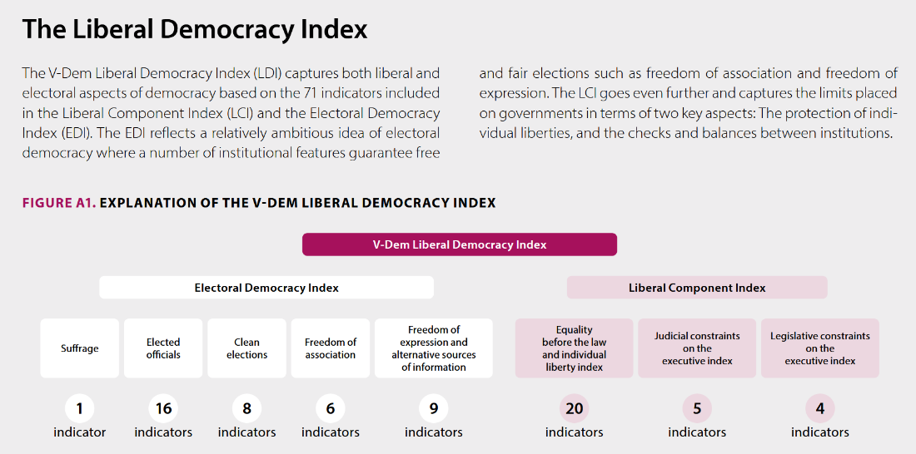
Measuring Democracy: V-Dem’s LDI
Source: V-Dem Democracy Report 2025. https://www.v-dem.net/documents/61/v-dem-dr__2025_lowres_v2.pdf

Slide 7
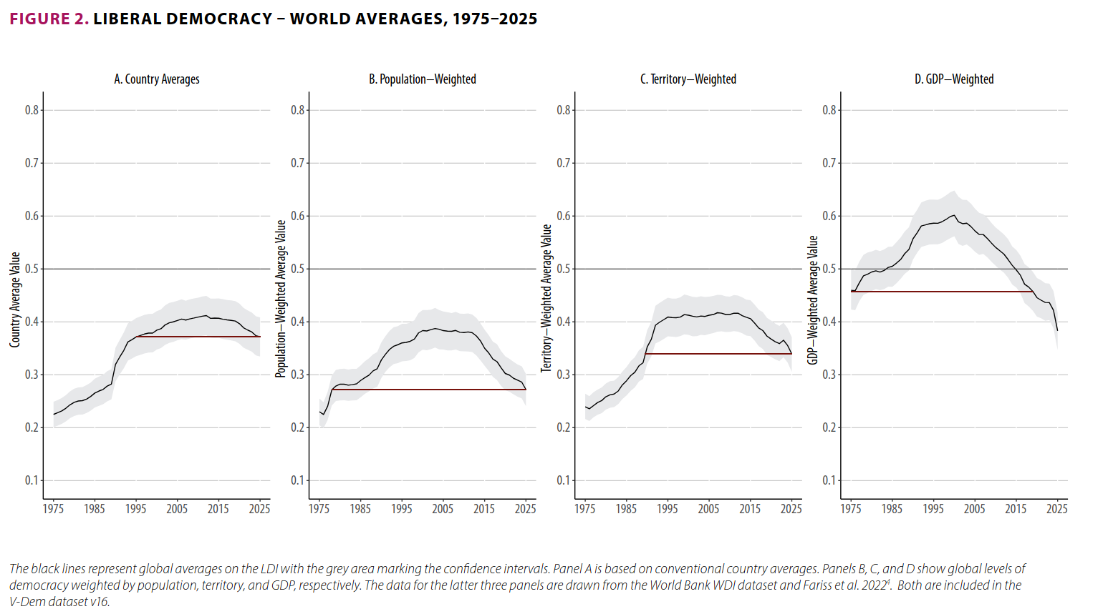
How is world democracy doing?
Source: V-Dem Democracy Report 2026. https://www.v-dem.net/documents/75/V-Dem_Institute_Democracy_Report_2026_lowres.pdf

Slide 8
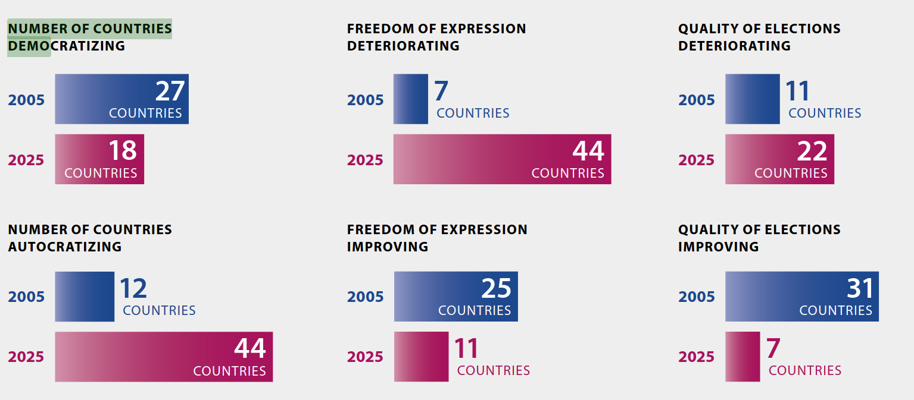
Democratic quality is eroding ( = backsliding)
Source: V-Dem Democracy Report 2026. https://www.v-dem.net/documents/61/v-dem-dr__2025_lowres_v2.pdf

Slide 9
Democratic backsliding, at its most basic, denotes the state-led debilitation or elimination of any of the political institutions that sustain an existing democracy. (Bermeo, 2016)

Slide 10
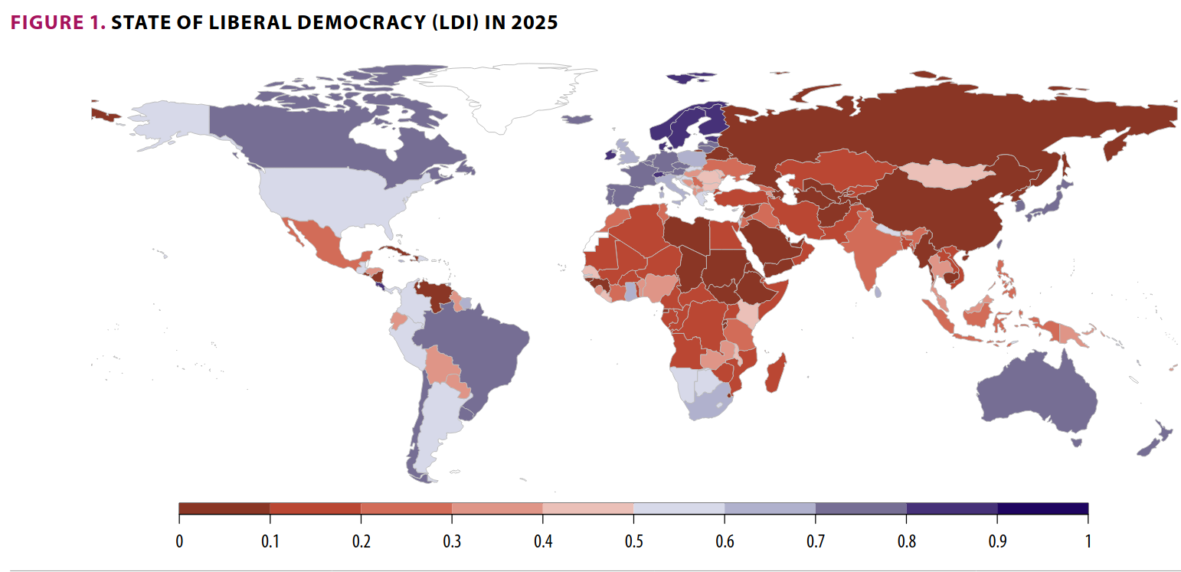
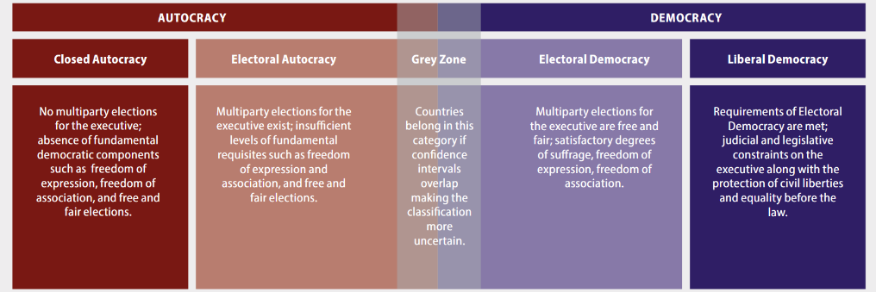
Source: V-Dem Democracy Report 2026. https://www.v-dem.net/documents/61/v-dem-dr__2025_lowres_v2.pdf
92
87
HYBRID REGIMES
35
56
59
29
(17)

Slide 11
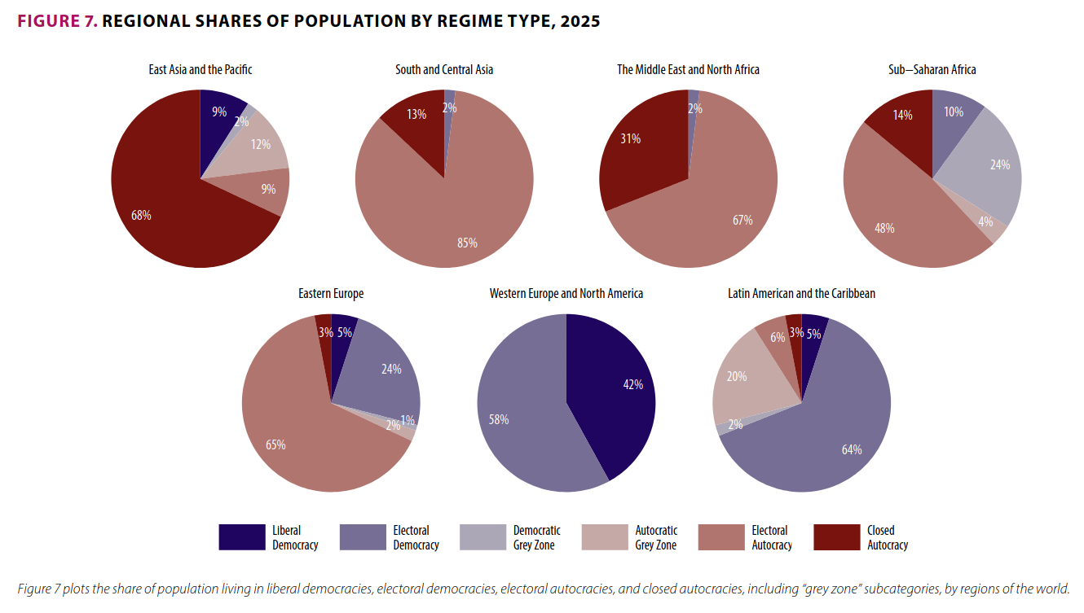
What about Europe?

Slide 12
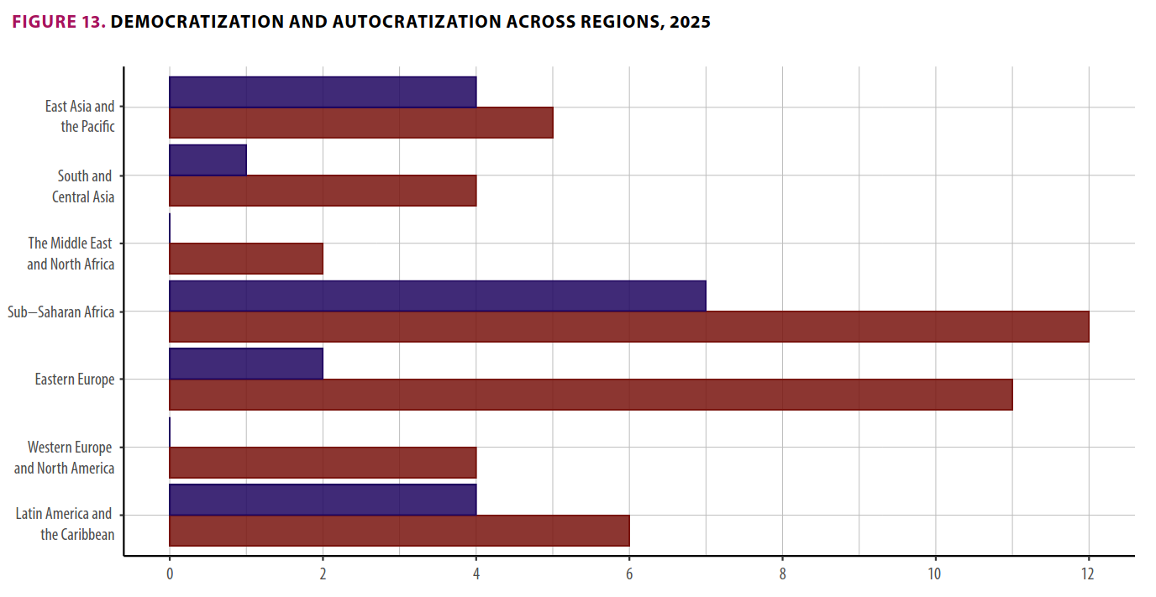
What about Europe?

Slide 13
Hybrid Regimes
Combine democratic rules with authoritarian governance
Many different terms
“semidemocracy”
“virtual democracy”
“electoral democracy”
“pseudodemocracy”
“illiberal democracy”
“semi-authoritarianism”
“soft authoritarianism”
“electoral authoritarianism”
…
Competitive Authoritarian Regimes (CARs) -> Levitsky & Way (2002, 2010, 2020)

Slide 14
CARs: Elections without Democracy
(Diminished) form of authoritarianism
Hybrid:
Formal democratic institutions = principal means to obtain & exercise political authority (democratic)
BUT incumbents systematically and aggressively violate these rules in order to gain advantage (autocratic)

Slide 15
CARs: Elections without Democracy
(Diminished) form of authoritarianism
Hybrid
Different from democracies & full authoritarianism
 | Democracy | CAR | Full Authoritarianism
Status of core democratic constitutions (elections, civil liberties) | Systematically respected. Widely viewed as only route to power | Exist and are meaningful, but systematically violated in favor of incumbent. Widely viewed as primary route to power. | Nonexistent or reduced to façade status. Not viewed as a viable route to power
Status of opposition | Competes on more or less equal footing with incumbent. | Major opposition is legal and can compete openly, but is significantly disadvantaged by incumbent abuse. | Major opposition banned, or largely underground or in exile.
Level of uncertainty | High | Lower than democracy but higher than full authoritarianism. | Low

Slide 16
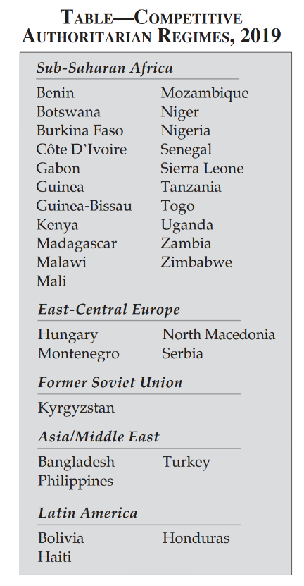
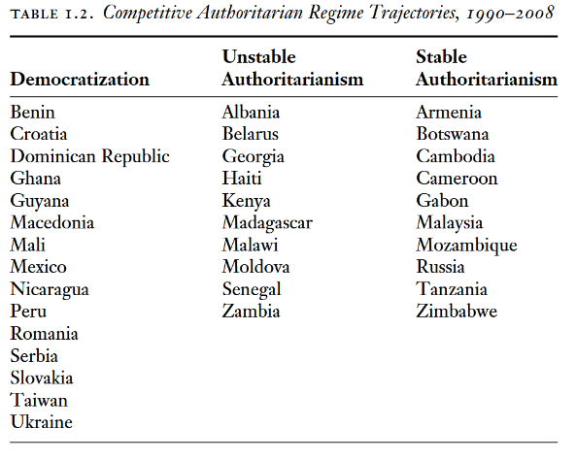
Evolution of CARs 1990-2019
Levitsky & Way (2010). Competitive Authoritarianism. p. 21.
Levitsky & Way (2020). The New Competitive Authoritarianism. p. 53.

Slide 17
The New Face of Competitive Authoritarianism
Previously countries with
Low income
No democratic tradition
Weak institutions or ROL
Underdeveloped private sector and civil society
Feeble opposition
Easy to create a CAR
Now countries with
strong and established democratic traditions
Developed economies
Robust private sectors and civil society
Strong opposition parties
Facing greater external scrutinity due to stronger ties with West

Slide 18
The New Face of Competitive Authoritarianism
Hungary, Turkey, Montenegro, Serbia, … : need for greater skill, more sophisticated strategies, and far more extensive popular mobilization
Create sizeable electoral majority
Use referendums or hypermajoritarian strategies to change rules of the game
Weaken opponents, lock in prospective autocrats’ hold on power

Slide 19
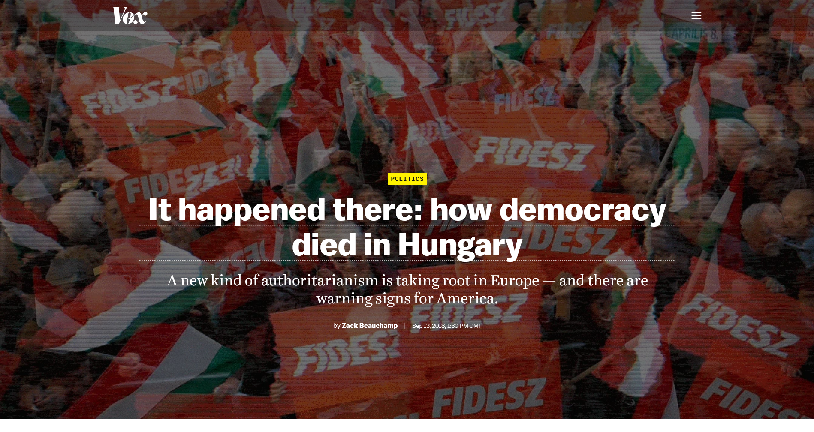
The case of Hungary: Victor Orbán’s Fidesz

Slide 20
The case of Hungary: democratic but corrupt
2010: Hungary considered a consolidated democracy with
strong institutions
a competitive partysystem
a vibrant civil society
free and diverse media
2002-2010: socialist-led coalition in power but many corruption scandals
Chronic tax evasion
Siphoning public funds
“Juking the stats”

Slide 21
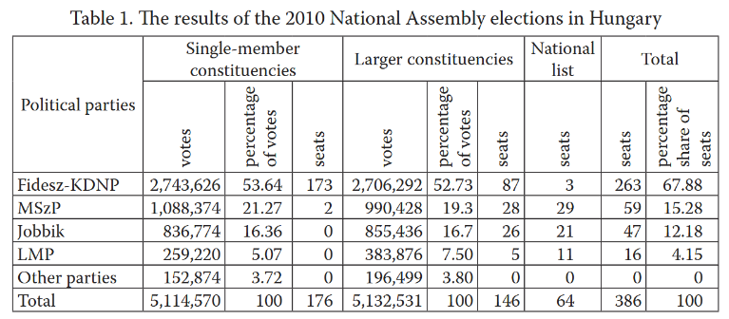
The case of Hungary: Victor Orbán’s Fidesz as the savior from socialist corruption
2010 elections: Orbán’s Fidesz secured 2/3 super majority
Source: Kubas & Czyż (2018). From a Liberal Opposition Party to a Right-Wing Party of Power. Three Decades of the Hungarian Fidesz (1988–2018). DOI: https://doi.org/10.17951/bc.2018.3.47-65

Slide 22
The case of Hungary: Locking in power
Removed checks on power of prime minister
Packed the state with loyal partisans
Control over news media
f.i. helping allied business people take over private sector media
Electoral reforms:
Gerrymandering
No more parliamentary runoff elections
No campaign on private media outlets

Slide 23
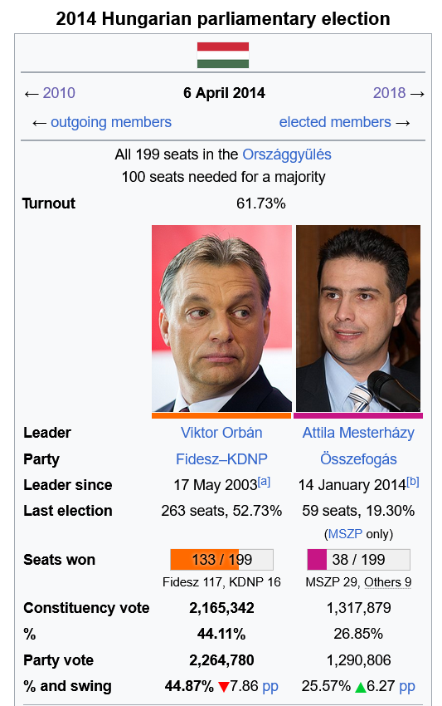
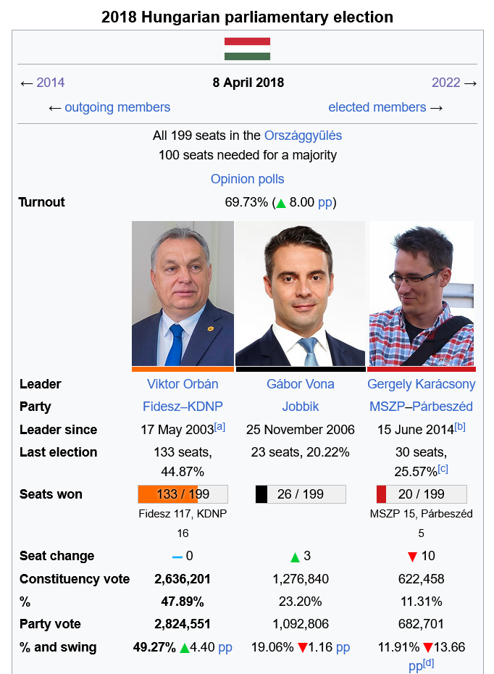
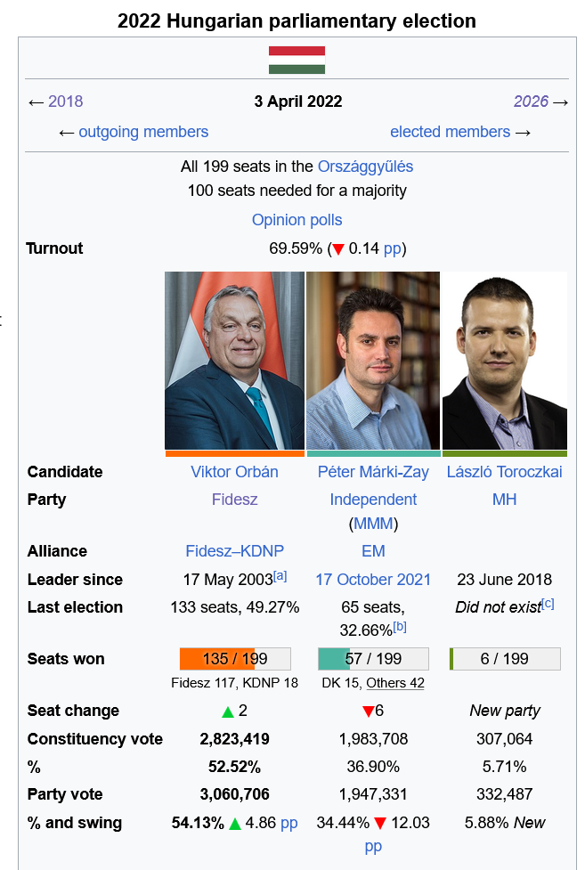
Result: endured power + democratic backsliding

Slide 24
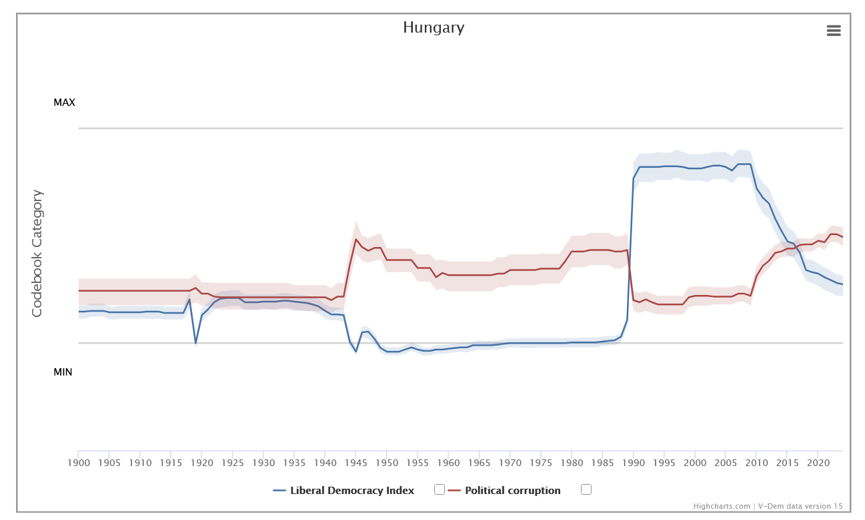
Result: endured power + democratic backsliding

Slide 25
Conclusion
Countries around the world have been experiencing democratic backsliding, i.e. the state-led erosion of existing democracy
Europe: mostly hybrid regimes -> most extreme cases are Competitive Authoritarian Regimes
Used to be only former authoritarian regimes, but now former democratic regimes
This requires prospective autocrats to be much more subtle
Monday: Role of Political Actors & Voters

